Slide 1
Building Multi-language Reports for Power BI in 2023
Ted Pattison
Principal Program Manager
Power BI Customer Advisory Team (PBICAT)

Slide 2
Agenda
Building Multi-language Reports in Power BI
Creating and Testing Metadata Translations
Generating Machine Translations
Creating and Testing Report Label Translations
Creating a Workflow To Integrate Human Translations
Implementing Data Translations using Field Parameters
Implementing Data Translations for a Calendar Table

Slide 3
Building Multi-language Reports in Power BI
Power BI provides Internationalization and localization features
You can design report that render in English, Spanish, French and German
It's no longer necessary to copy/maintain a separate PBIX file per language
Building multi-language reports will decrease maintenance and overhead
Recent Power BI Enhancements for Building Multi-language Reports
USERCULTURE function now supported and used to create measures with dynamic translations
More properties for report visuals and shapes can be dynamically configured with measures
Introduction of Field Parameters offers much better options to implement data translations
This guidance is based on using an external tool named Translations Builder
Translations Builder designed to work together with Power BI Desktop
Translations Builder v1 originally published in July 2021
Translations Builder v2 published in January 2023 with significant productivity enhancements

Slide 4
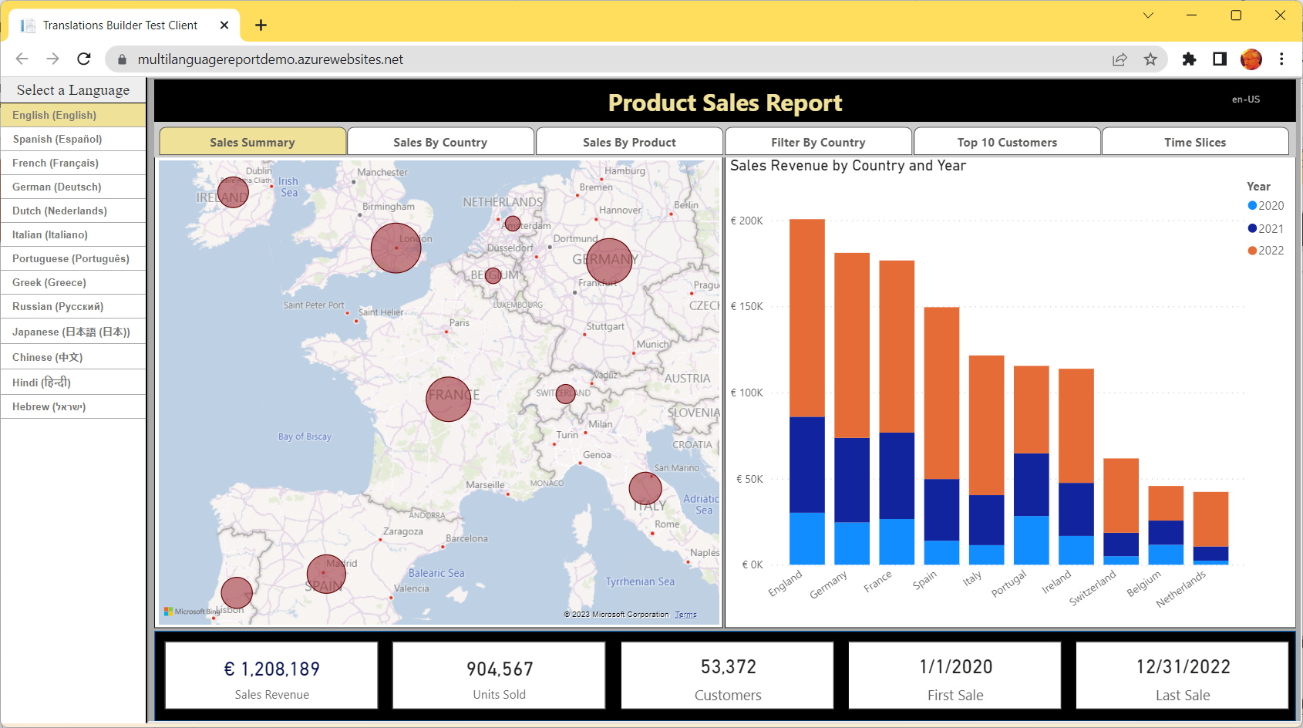
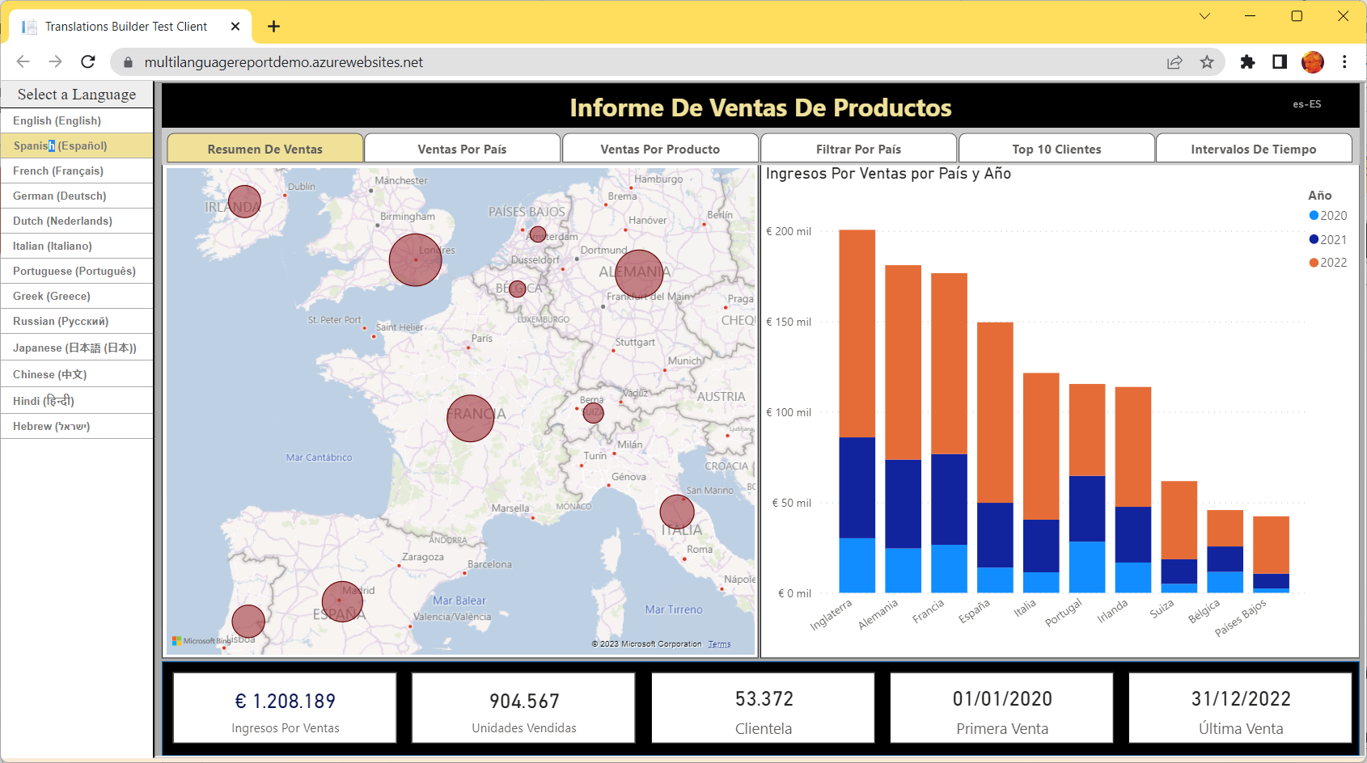
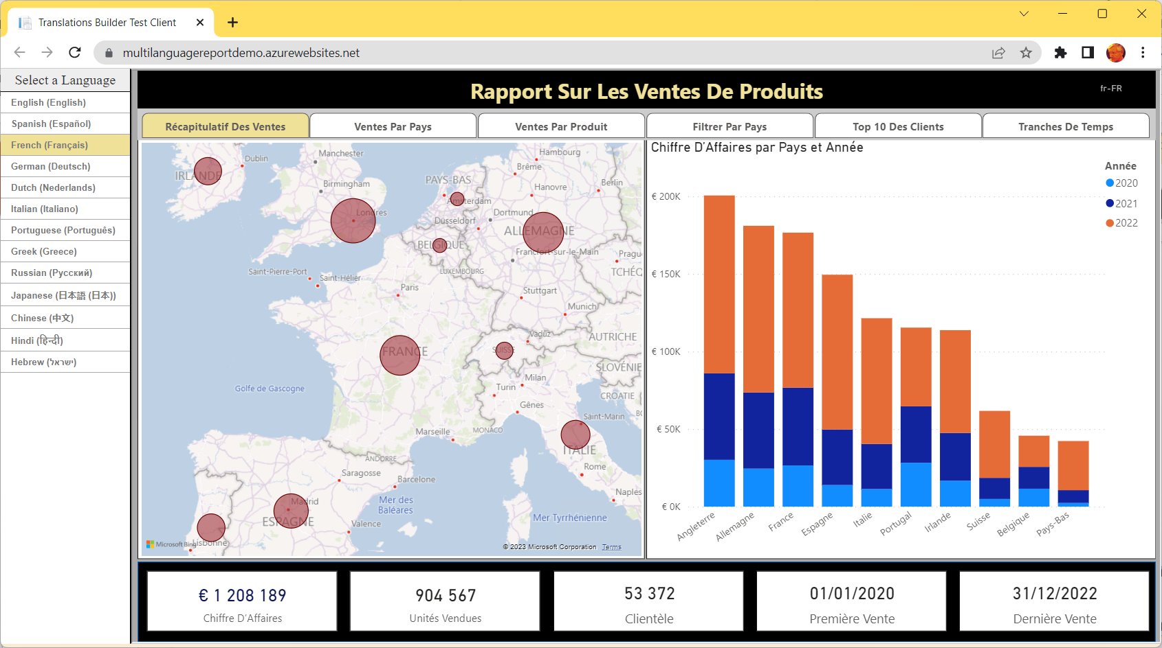
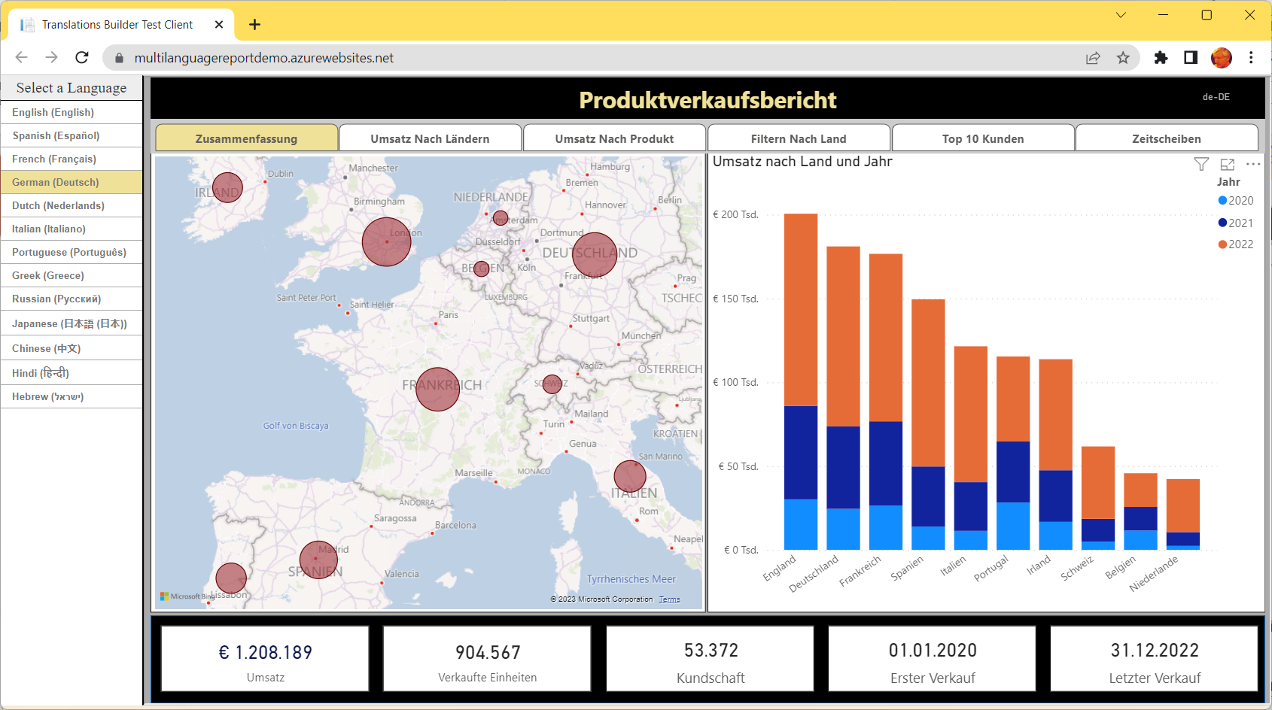
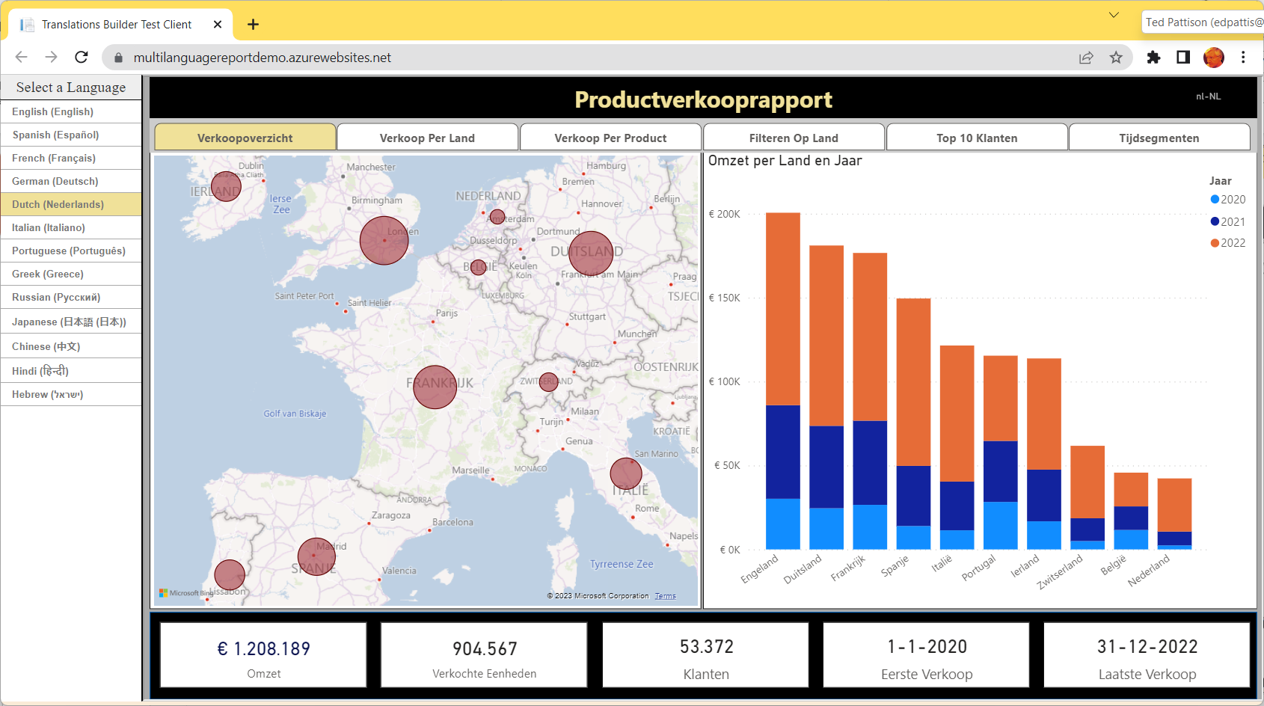
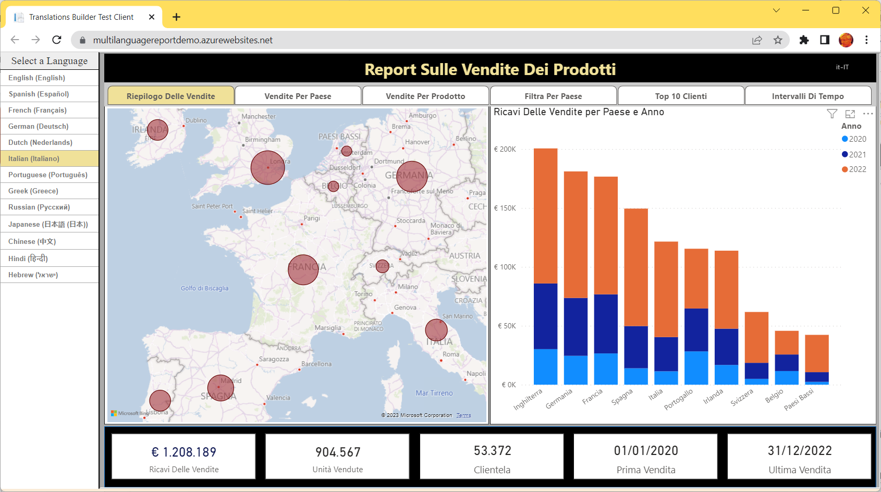
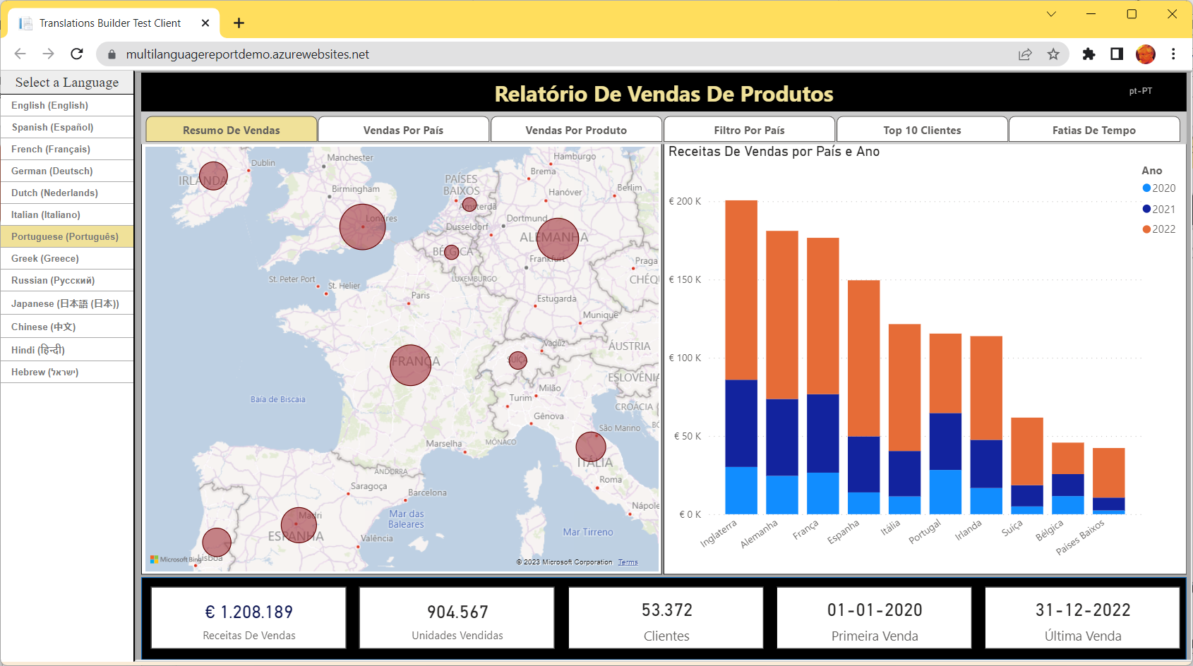
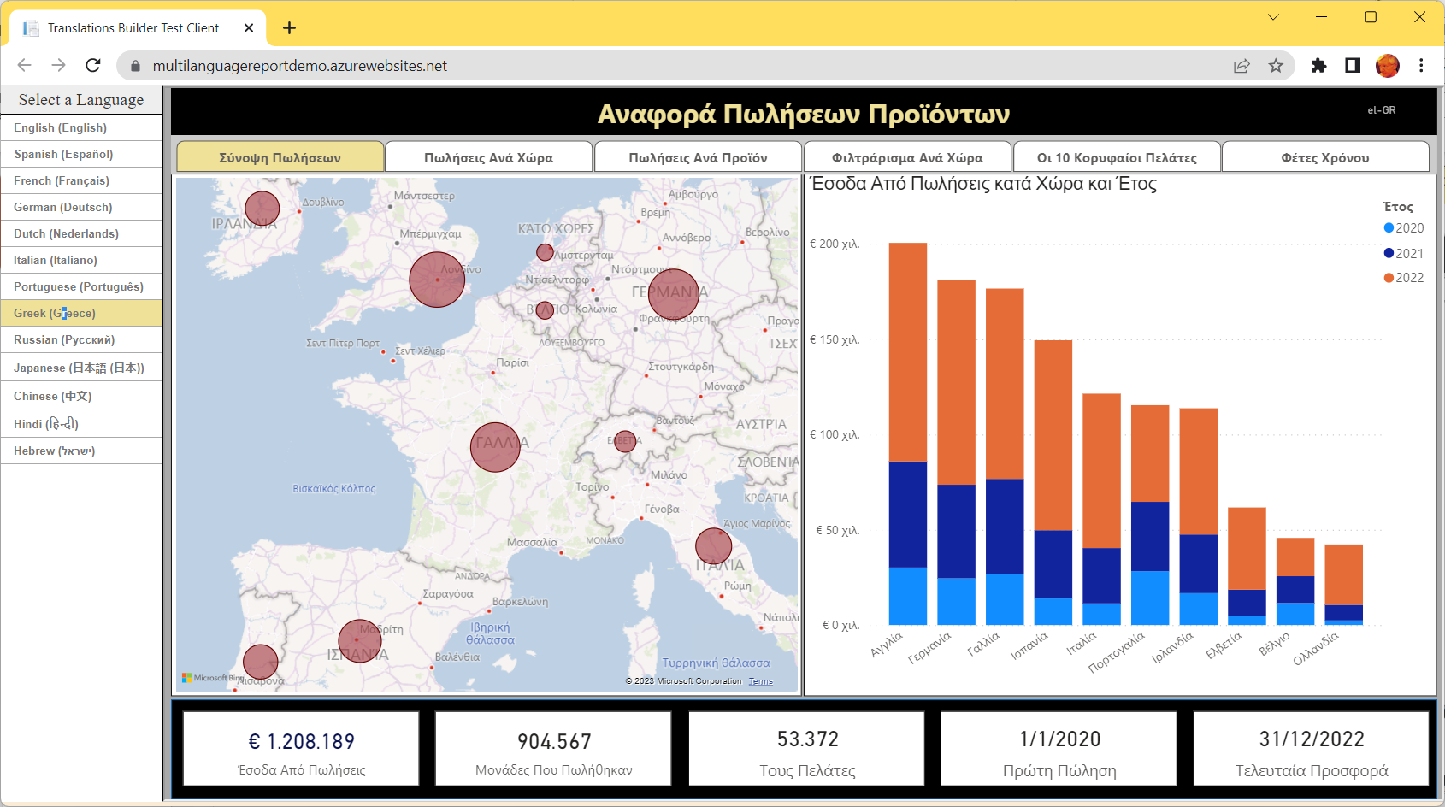
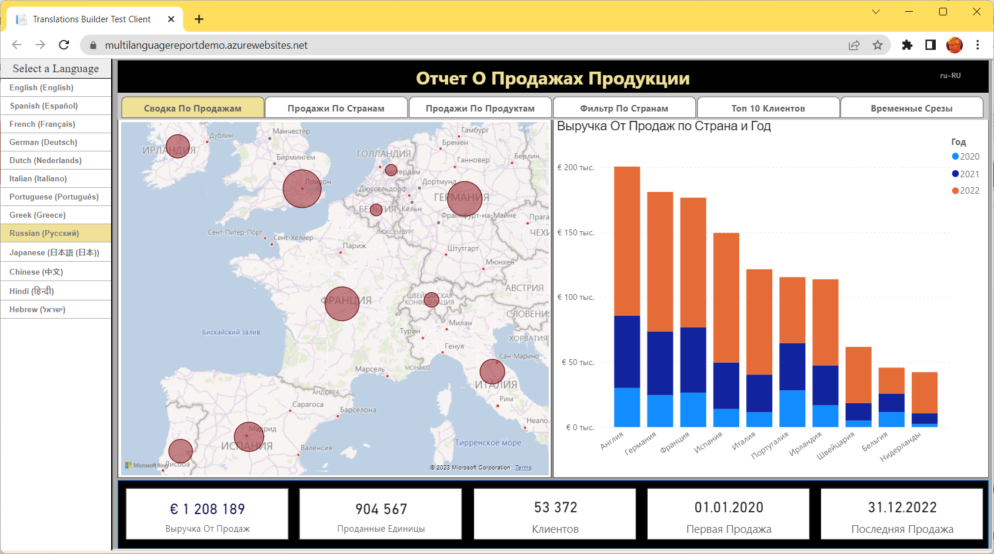
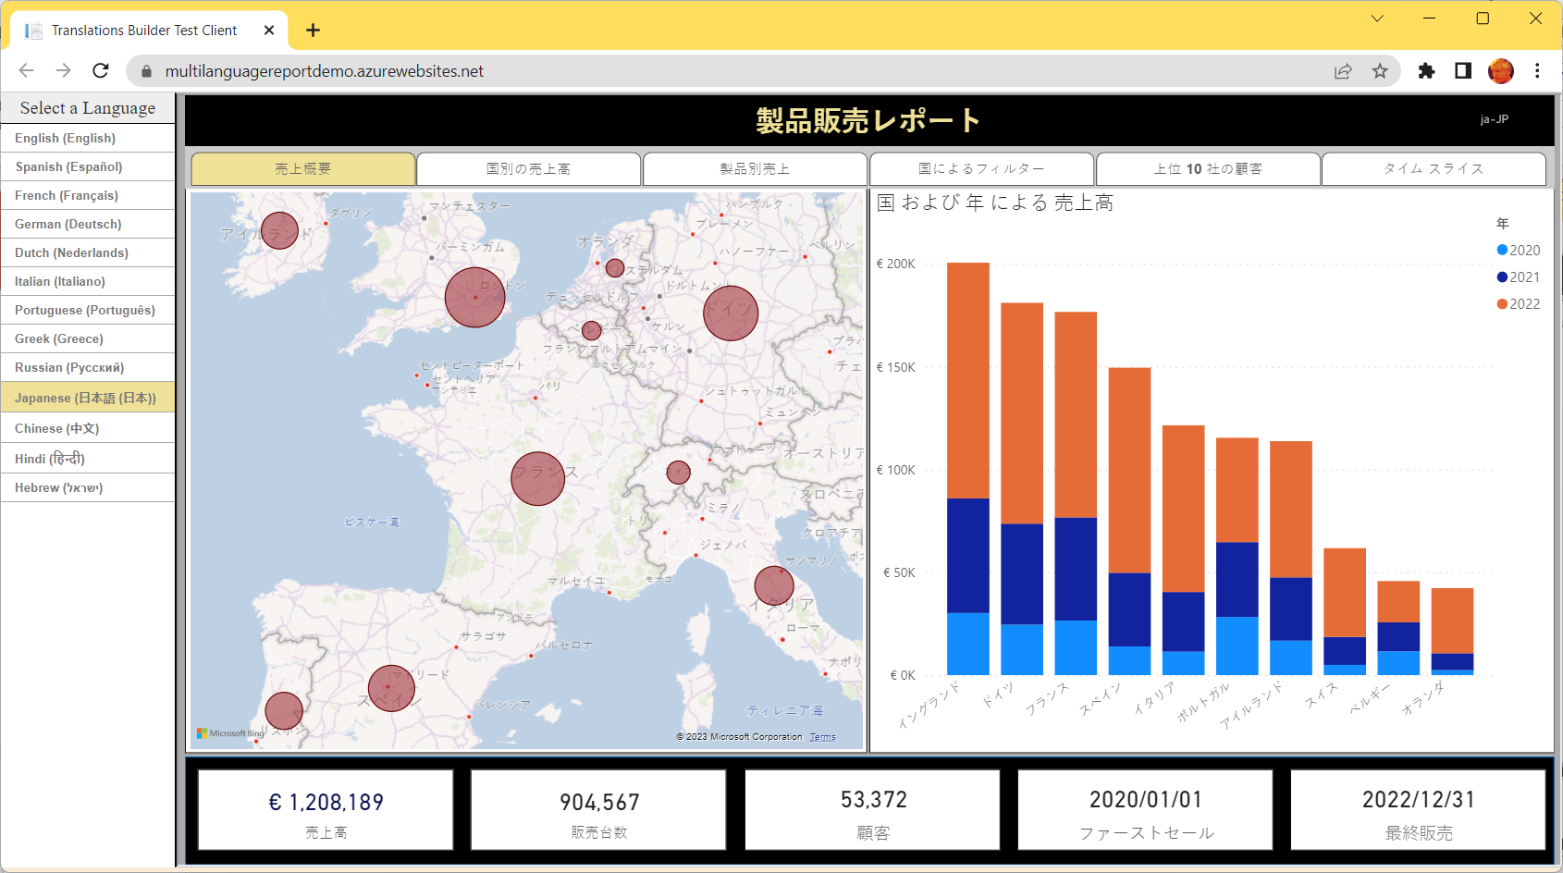
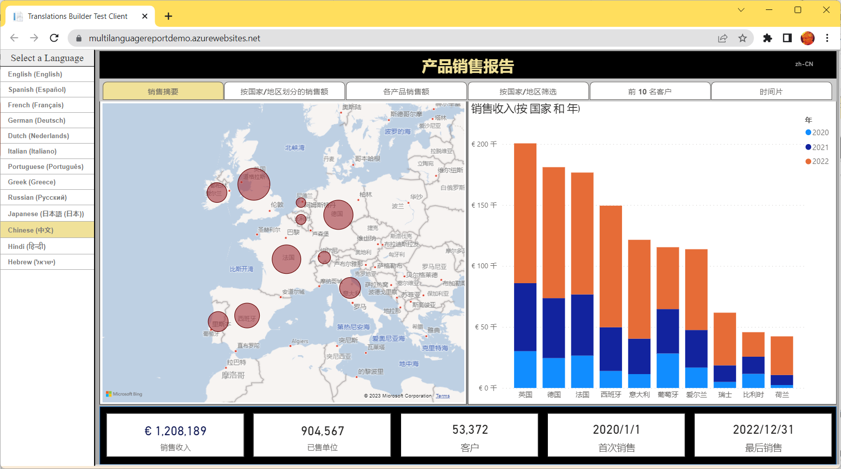
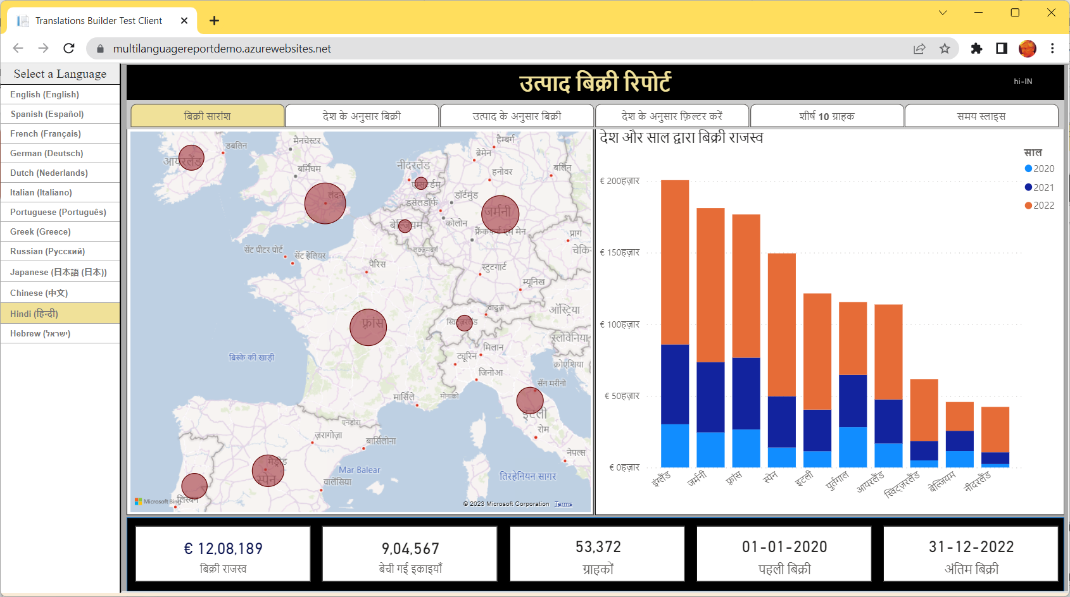
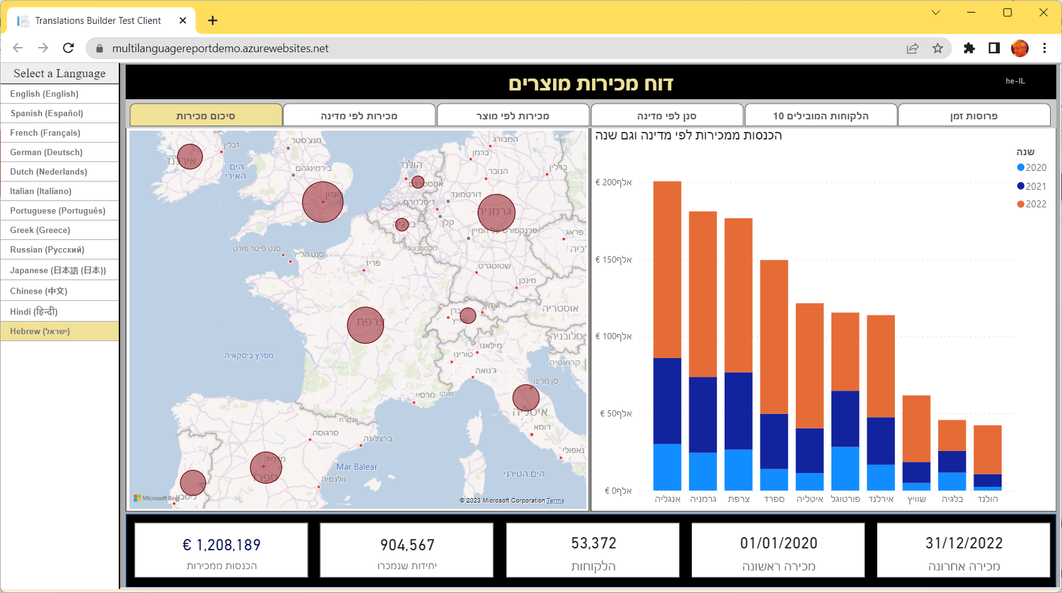
Multi-language Report Live Demo
https://multilanguagereportdemo.azurewebsites.net

Slide 5
Power BI Support for Metadata Translations
Power BI supports metadata translations for the properties of dataset objects
Supported object types include Table, Column, Measure, Hierarchy and Hierarchy Level
Supported object properties include Caption, Description and DisplayFolder
Metadata translations currently require Power BI Premium – not supported in shared capacity
Metadata translations only support for Power BI datasets – not for report layouts
Report Layout does not support localization
Dataset Definition
supports localization
Metadata translations stored inside context of dataset definition
PBIX File (ProductSales.pbix)

Slide 6
Power BI Reports Load with Language and Locale of User
Every report loads with a specific language and a specific locale
Default behavior is to load report with language and locale of user’s browser settings
Language and locale setting can be overridden by adding language parameter to report URL
Language and locale setting can be controlled when loading report with Power BI embedding
DAX recently extended with USERCULTURE function
USERCULTURE returns a string with language and locale of current user
USERCULTURE | Language | Locale
en-US | English | United States
es-ES | Spanish | Spain
fr-FR | French | France
de-DE | German | Germany
Ja-JP | Japanese | Japan

Slide 7
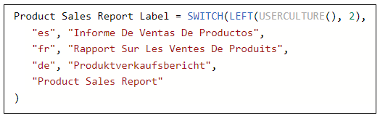
Implementing Dynamic Translations with USERCULTURE
Determine language of current user
Inspect the first two characters returned by USERCULTURE
Basic pattern for DAX expression to implement translations dynamically
Use SWITCH function with language identifier to dynamically return correct translation
Pattern falls back on the default language (en) when there is no match

Slide 8
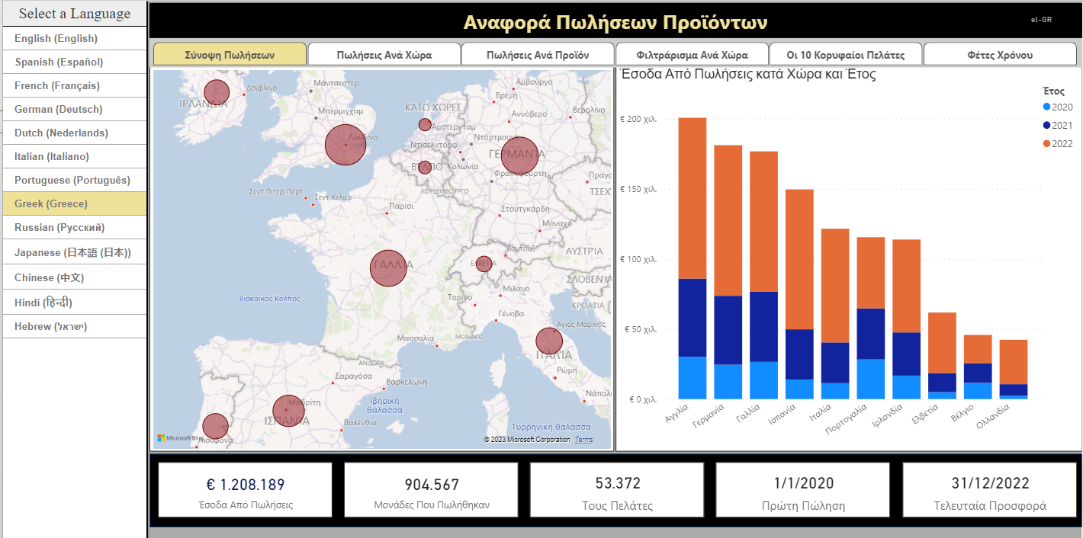
Determining the Language and Locale of Current User
Live demo and lab exercises display result of USERCULTURE to user in top banner
Included for content creators learning how build multi-language reports
Not something you would likely do in real production application

Slide 9
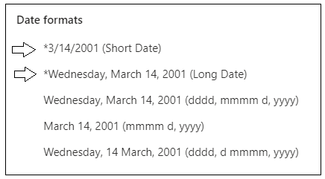
Formatting Dates and Numbers with Current User Locale
Power BI visuals inspect locale of current user when formatting numbers and dates
In most cases, visual will display values with correct formatting for current user’s locale
Make sure you use column and measure formatting settings that support regional formatting
Example of Short Date formatting across different locales
en-US | 12/31/2022
en-GB | 31/12/2022
pt-PT | 31-12-2022
de-DE | 31.12.2022
ja-JP | 2022/12/31

Slide 10
Understanding the Three Types of Translations
Metadata translations (always required)
Translations for dataset object names such as tables, columns and measures
Report label translations (always required)
Translations for literal string values used in report
Provides localized text for report titles, section headings, button captions, etc.
Data Translations (sometimes required)
Translations of text-based column values in the rows of underlying data being analyzed

Slide 11
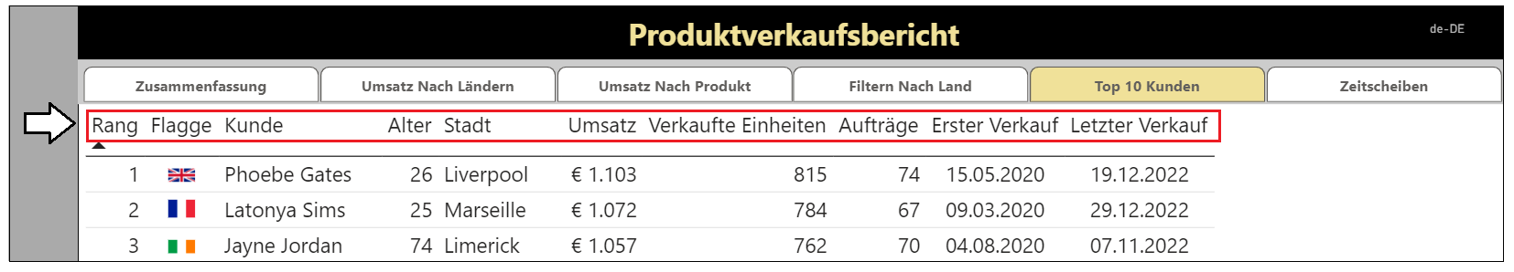
Metadata Translations for Columns and Measure Names
Metadata translations provide localized values for dataset object names
Metadata translations provide translated names for columns in a table
Metadata translations provide translated names for measures
Metadata translations are the easiest to create, manage and integrate into Power BI report

Slide 12
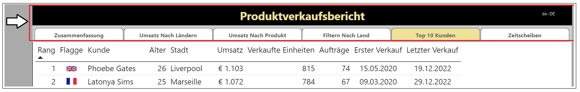
Report Label Translations
Report label translations provide localized values for text elements on report
Specifically for text elements not directly associated with a dataset object
Examples include the report title, section headings and button captions
Power BI provides no direct feature support for report labels translations
Best practice to implement report label translations with USERCULTURE and dynamic measures

Slide 13
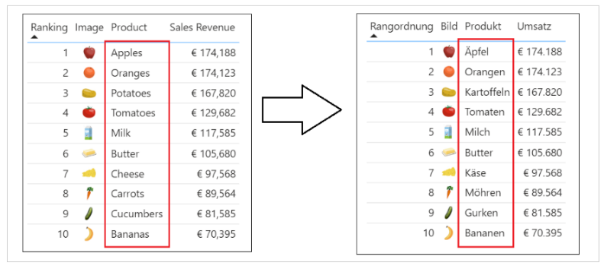
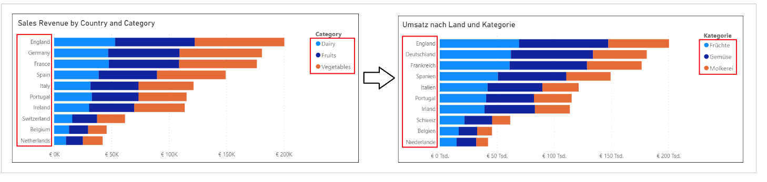
Data Translations
Data translations used to localize text values from underlying rows of data
Examples in the live demo include translated names for products, categories and countries
Data translations require the most effort to implement
It’s a best practice to implement data translations using the new Field Parameter feature

Slide 14
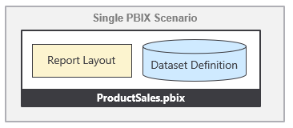
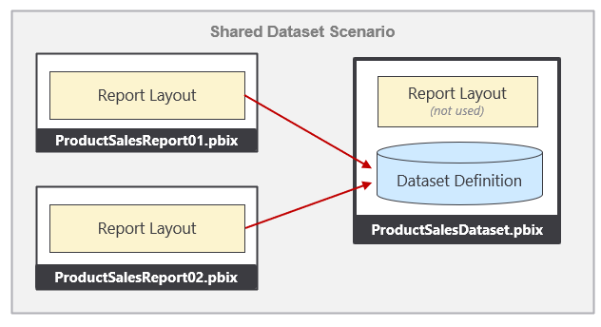
Packaging Dataset and Report in PBIX Project Files
There are two popular styles of managing datasets and reports in Power BI Desktop
Maintain dataset definition and report layout in a single PBIX project file for convenience
Split dataset definitions and report layout into separate PBIX project files
This guidance will work equally well with Style 1 and Style 2

Slide 15
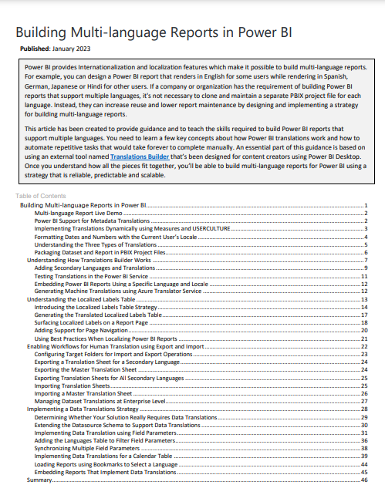
Guidance Document
Building Multi-language Reports in Power BI
https://aka.ms/MultiLanguageReportGuidance

Slide 16
Try Out Our New Hands-on Lab Exercises
Hands-on Lab: Building Multi-language Reports for Power BI
https://aka.ms/MultiLanguageReportLab
Sequence of lab exercises
Exercise 1: Creating and Testing Metadata Translations
Exercise 2: Generating Machine Translations
Exercise 3: Creating and Testing Report Label Translations
Exercise 4: Creating a Workflow Process To Gather and Integrate Human Translations
Exercise 5: Implementing Data Translations using Field Parameters
Exercise 6: Implementing Data Translations for a Calendar Table

Slide 17
Coming up next… Building Multi-language Reports for Power BI in 2023 Part 2 - Creating and Testing Metadata Translations

Slide 18
Agenda
Building Multi-language Reports in Power BI
Creating and Testing Metadata Translations
Generating Machine Translations
Creating and Testing Report Label Translations
Creating a Workflow To Integrate Human Translations
Implementing Data Translations using Field Parameters
Implementing Data Translations for a Calendar Table

Slide 19
Building Multi-language Reports for Power BI in 2023 Part 2 - Creating and Testing Metadata Translations

Slide 20
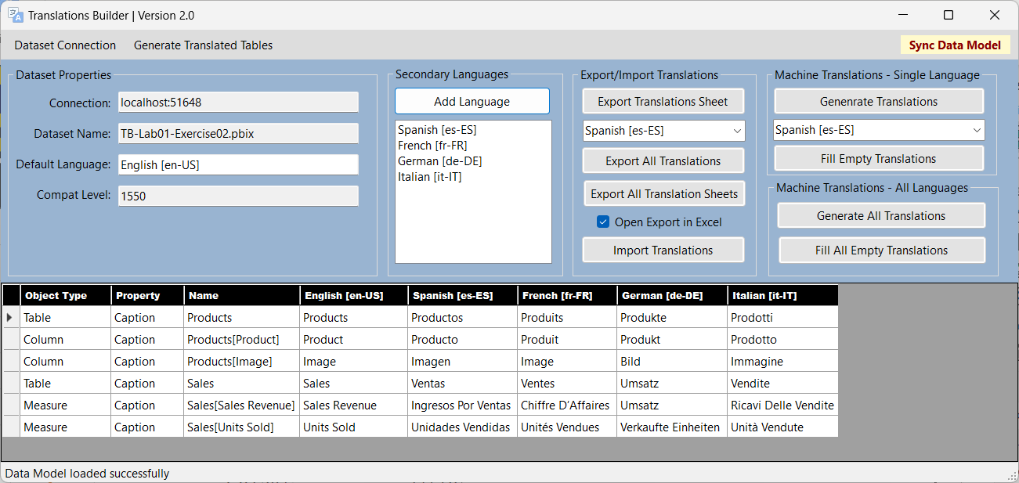
Translations Builder 2.0
Translations Builder is tool designed for content creators using Power BI Desktop
Content creators can use this tools to add multi-language support to PBIX project files

Slide 21
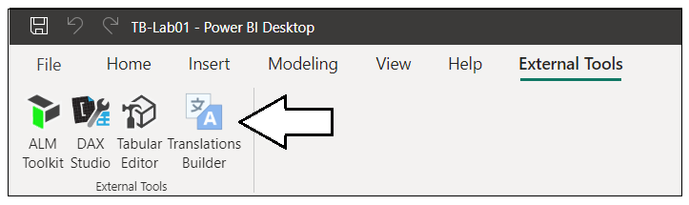
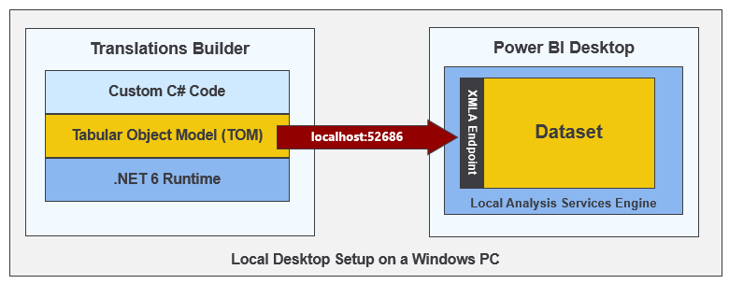
Launching Translations Builder

Slide 22
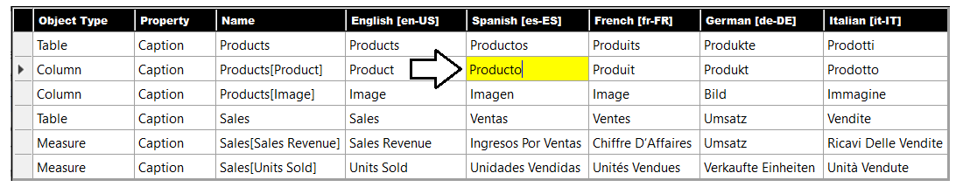
Working in the Translation Grid
Translations Builder
Allows user to view, add and update metadata translations using a two-dimensional grid
Abstracts away detail of read/writing object metadata to/from dataset
Provides simplified user editing experience similar to Microsoft Excel

Slide 23
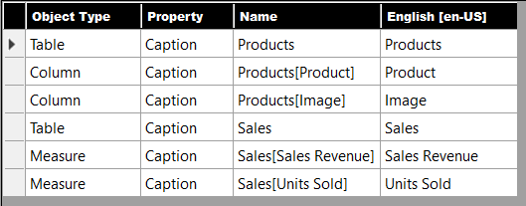
Understanding How Metadata Translations Are Identified
Each metadata translation identified using Object Type, Property and Name
Translations for Caption property is by far the most common
Translations for Description and DisplayFolder property not as common but can be used

Slide 24
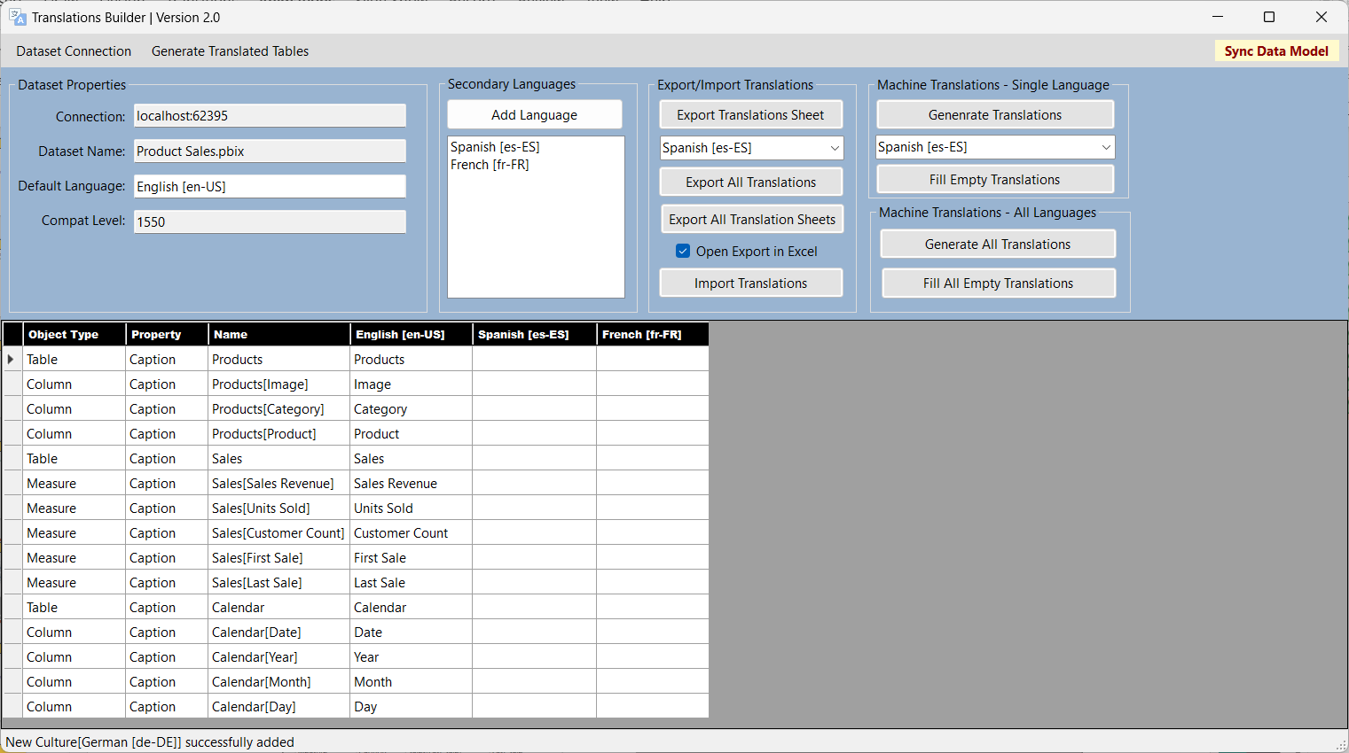
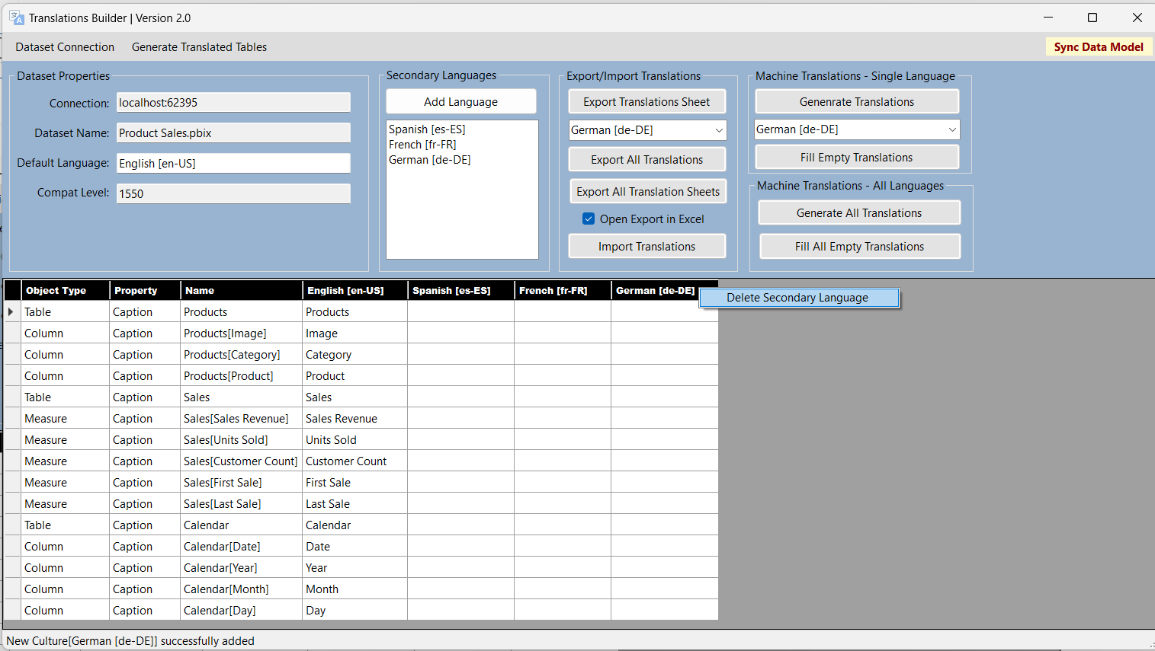
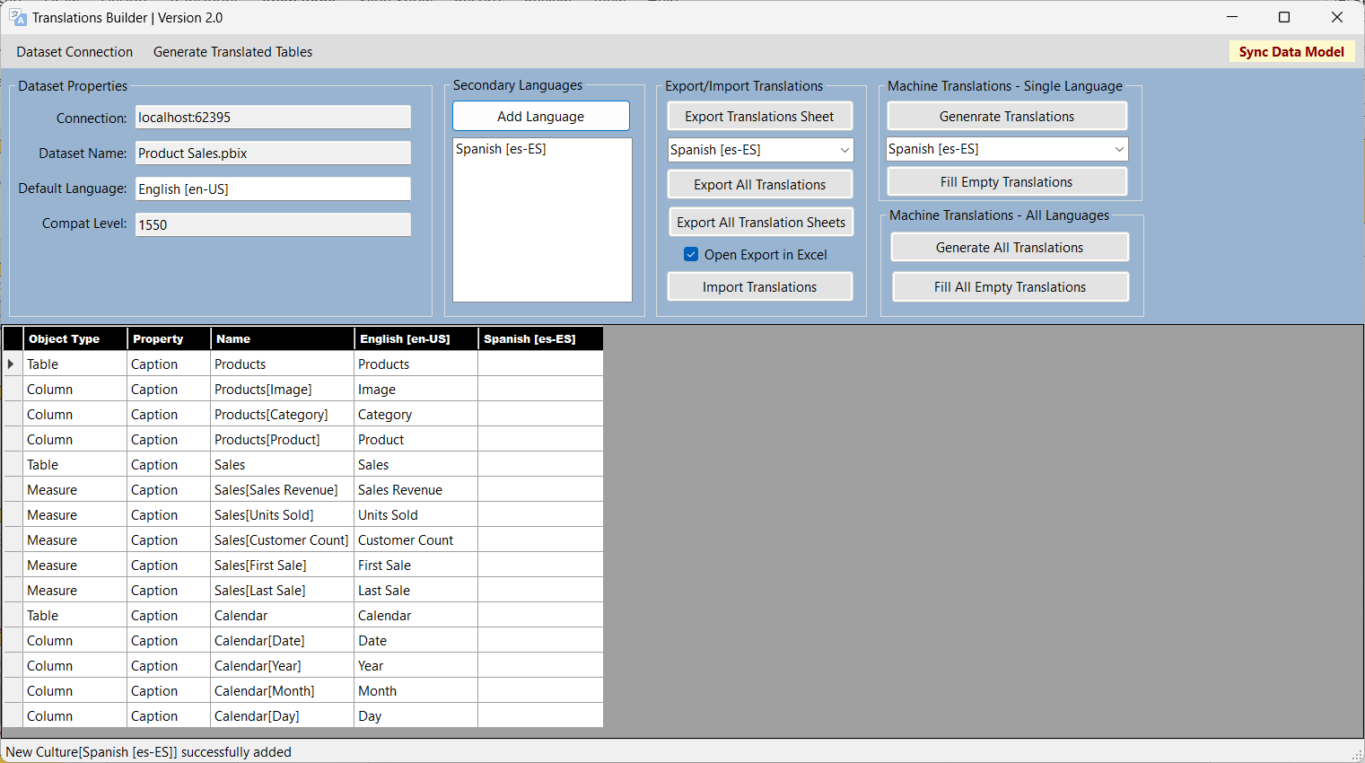
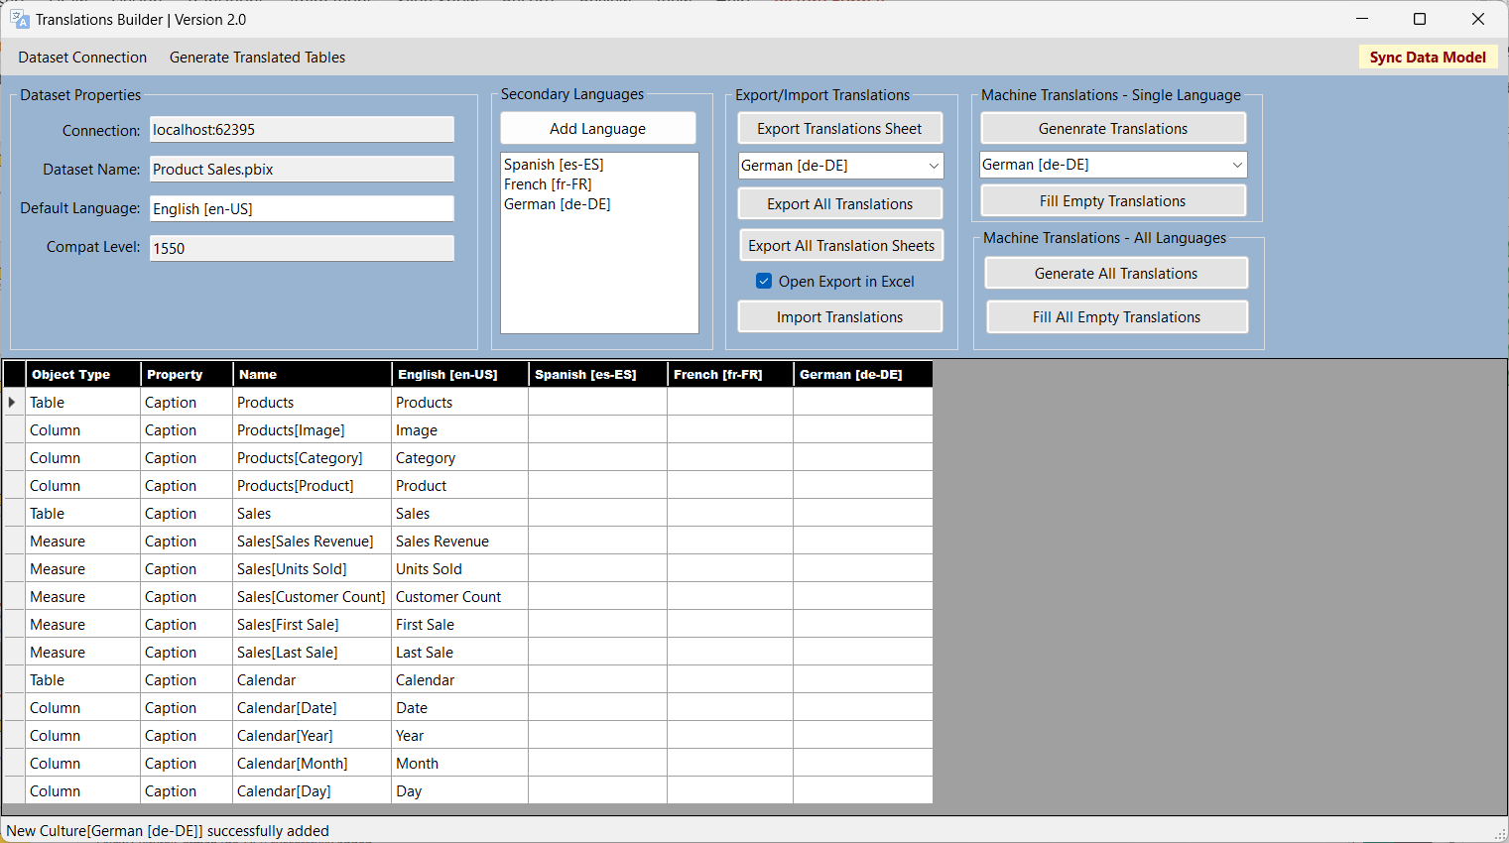
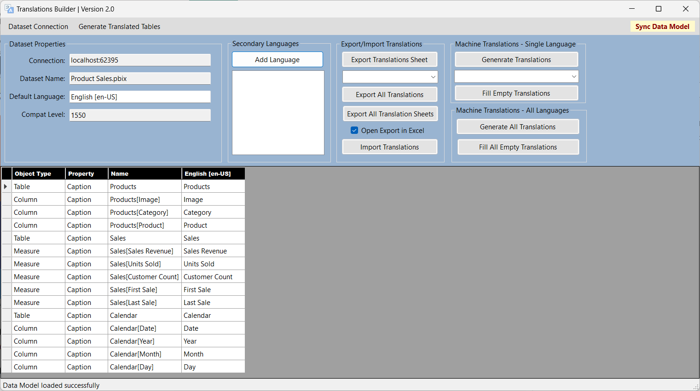
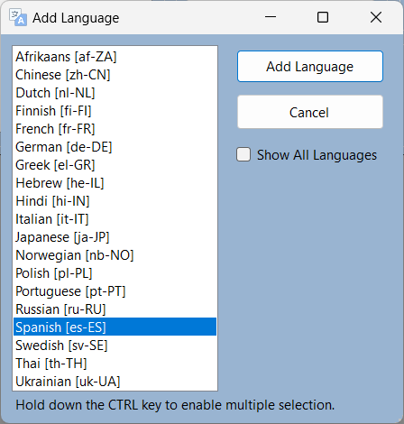
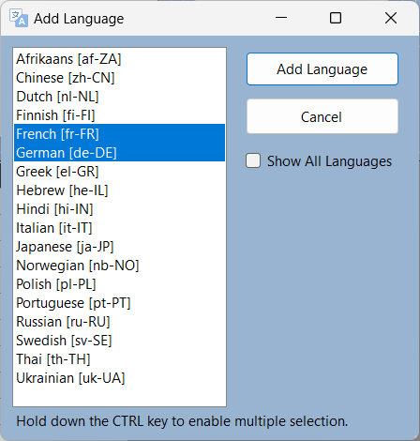
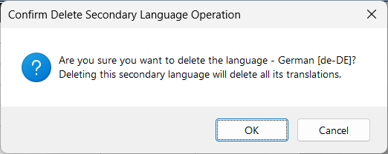
Adding Languages
Translations Builder provide commands for adding and removing languages

Slide 25
Adding and Editing Translations

Slide 26
Testing Metadata Translations in Power BI Service
Metadata translations cannot be tested in Power BI Desktop
Analytics engine for Power BI Desktop will not load translation.
Dataset/report must be published to Power BI Service for Testing
Workflow for Building Multi-language Reports
Add translations to dataset PBIX project file using Power BI Desktop and Translations Builder
Save PBIX project file and publish to the Power BI Service
Test translations in Power BI Service using language parameter on report URL
Repeat steps 1-3

Slide 27
Agenda
Building Multi-language Reports in Power BI
Creating and Testing Metadata Translations
Generating Machine Translations
Creating and Testing Report Label Translations
Creating a Workflow To Integrate Human Translations
Implementing Data Translations using Field Parameters
Implementing Data Translations for a Calendar Table

Slide 28
Building Multi-language Reports for Power BI in 2023 Part 3 - Generating Machine Translations

Slide 29
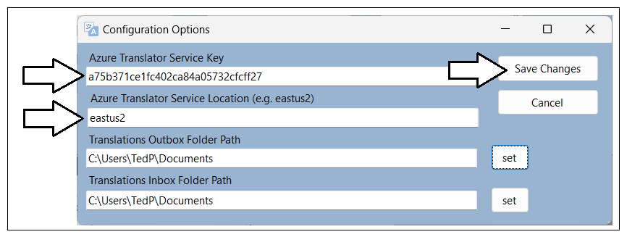
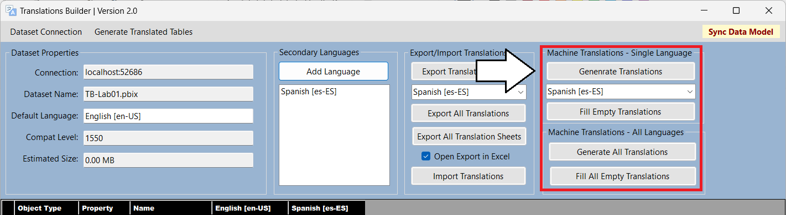
Machine Translations and Azure Translator Service

Slide 30
Agenda
Building Multi-language Reports in Power BI
Creating and Testing Metadata Translations
Generating Machine Translations
Creating and Testing Report Label Translations
Creating a Workflow To Integrate Human Translations
Implementing Data Translations using Field Parameters
Implementing Data Translations for a Calendar Table

Slide 31
Building Multi-language Reports for Power BI in 2023 Part 4 - Creating and Testing Report Label Translations

Slide 32
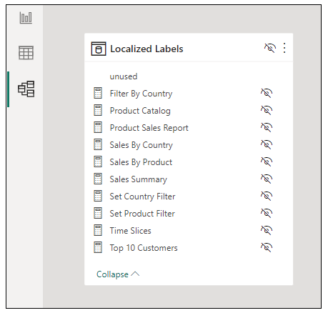
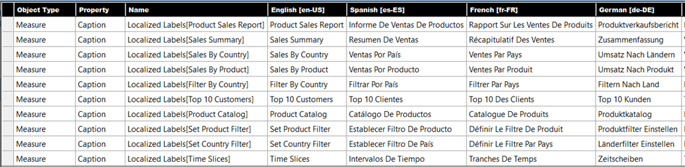

Slide 33
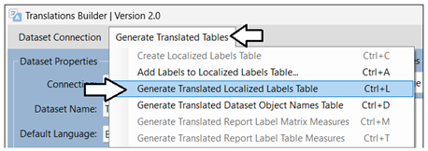
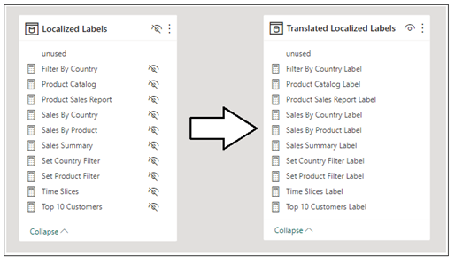

Slide 34
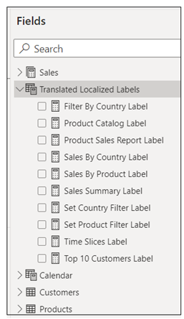
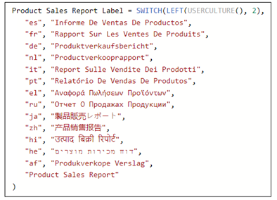

Slide 35
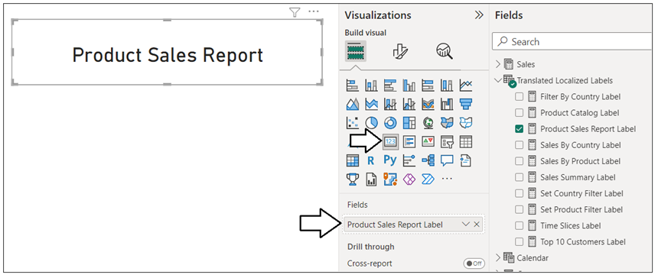

Slide 36
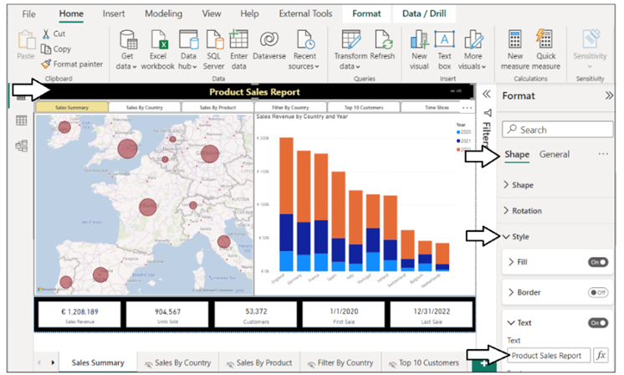
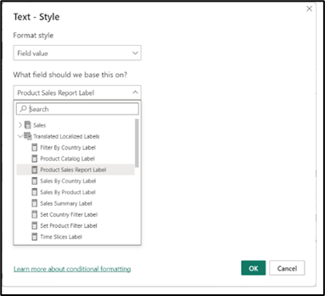

Slide 37
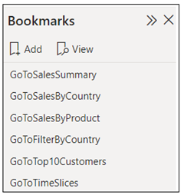
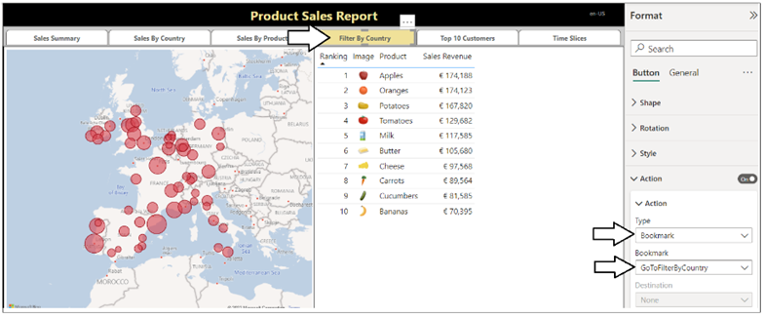
Page Navigation

Slide 38
Agenda
Building Multi-language Reports in Power BI
Creating and Testing Metadata Translations
Generating Machine Translations
Creating and Testing Report Label Translations
Creating a Workflow To Integrate Human Translations
Implementing Data Translations using Field Parameters
Implementing Data Translations for a Calendar Table

Slide 39
Building Multi-language Reports for Power BI in 2023 Part 5 - Creating a Workflow To Integrate Human Translations

Slide 40
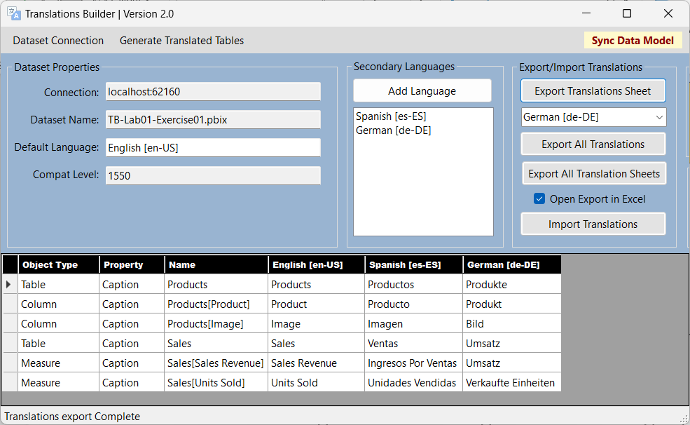


Human Workflow
Outbox
Project1-Translations-Spanish.csv
Export Translation Sheet
Project1-Translations-German.csv
Export Translation Sheet

Slide 41

Human Workflow
Outbox
Project1-Translations-Spanish.csv
Export Translation Sheet
Project1-Translations-German.csv
Export Translation Sheet
Inbox
Import Translation Sheet
Project1-Translations-Spanish.csv
Import Translation Sheet
Project1-Translations-German.csv

Slide 42
Enterprise Level Management
PBIX Project 1
Master
Translation
Sheet
PBIX Project 2
Export Operation
Import Operation

Slide 43
Enterprise Level Management
New PBIX
Project 1
Enterprise Master
Translation Sheet
Import Operation
Import Operation
New PBIX
Project 2
Import Operation
New PBIX
Project 3

Slide 44
Agenda
Building Multi-language Reports in Power BI
Creating and Testing Metadata Translations
Generating Machine Translations
Creating and Testing Report Label Translations
Creating a Workflow To Integrate Human Translations
Implementing Data Translations using Field Parameters
Implementing Data Translations for a Calendar Table

Slide 45
Building Multi-language Reports for Power BI in 2023 Part 6 - Implementing Data Translations using Field Parameters

Slide 46


Field Parameters
column
selector

Slide 47
Agenda
Building Multi-language Reports in Power BI
Creating and Testing Metadata Translations
Generating Machine Translations
Creating and Testing Report Label Translations
Creating a Workflow To Integrate Human Translations
Implementing Data Translations using Field Parameters
Implementing Data Translations for a Calendar Table

Slide 48
Building Multi-language Reports for Power BI in 2023 Part 7 - Implementing Data Translations for a Calendar Table

Slide 49



Languages
Power Query Transforms
Translated Month Names Table
Translated Day Names Table

Slide 50
Summary
Building Multi-language Reports in Power BI
Creating and Testing Metadata Translations
Generating Machine Translations
Creating and Testing Report Label Translations
Creating a Workflow To Integrate Human Translations
Implementing Data Translations using Field Parameters
Implementing Data Translations for a Calendar Table

